Slide 1

Coffee Shops Analysis - Toronto

Slide 2

Contents
Introduction
Existing Joints in City
Suggestion’s For new Joints

Slide 3
Introduction
Analyze Coffee Places in the city of Toronto based on the neighborhood.
Prospective neighborhood’s for new coffee Places in the City

Slide 4
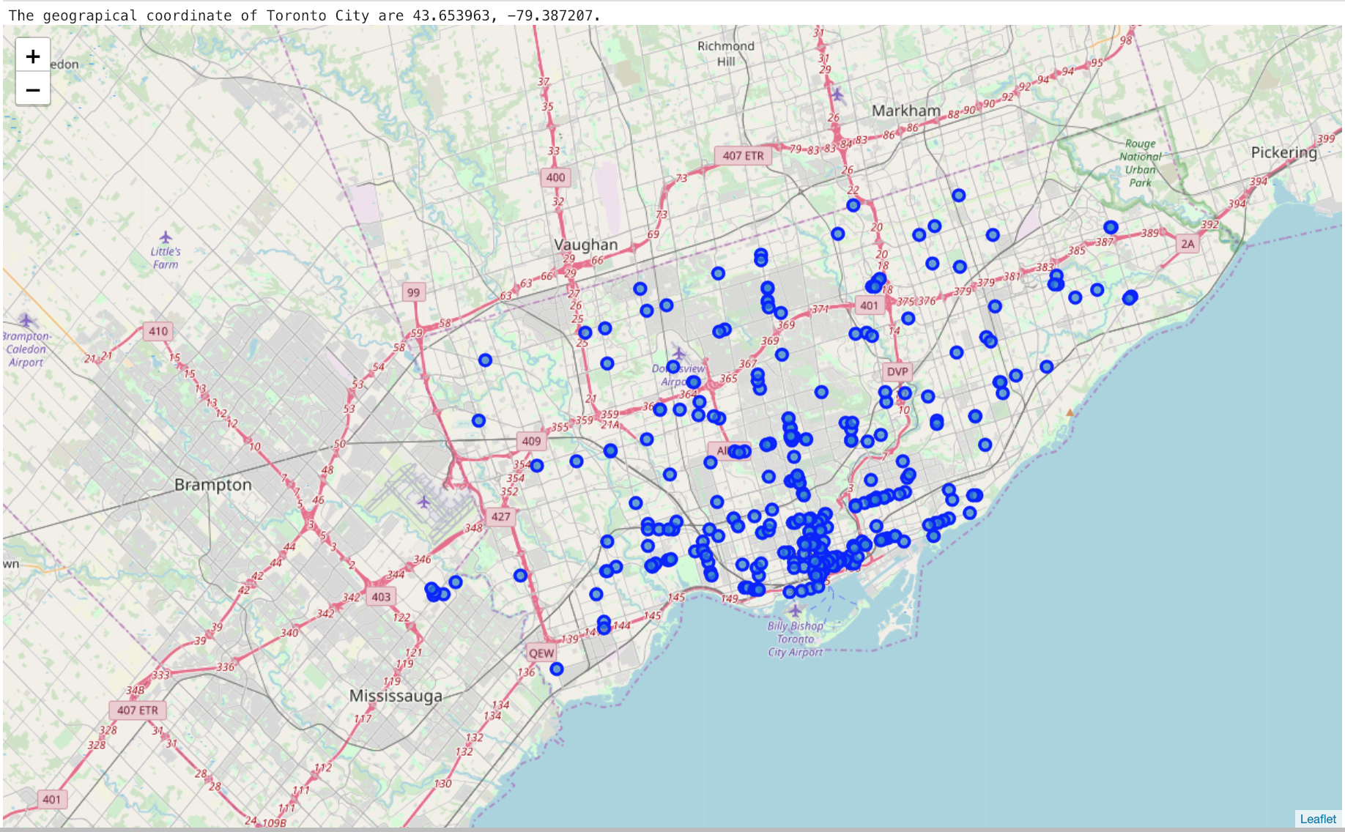
Existing Coffee Joints

Slide 5
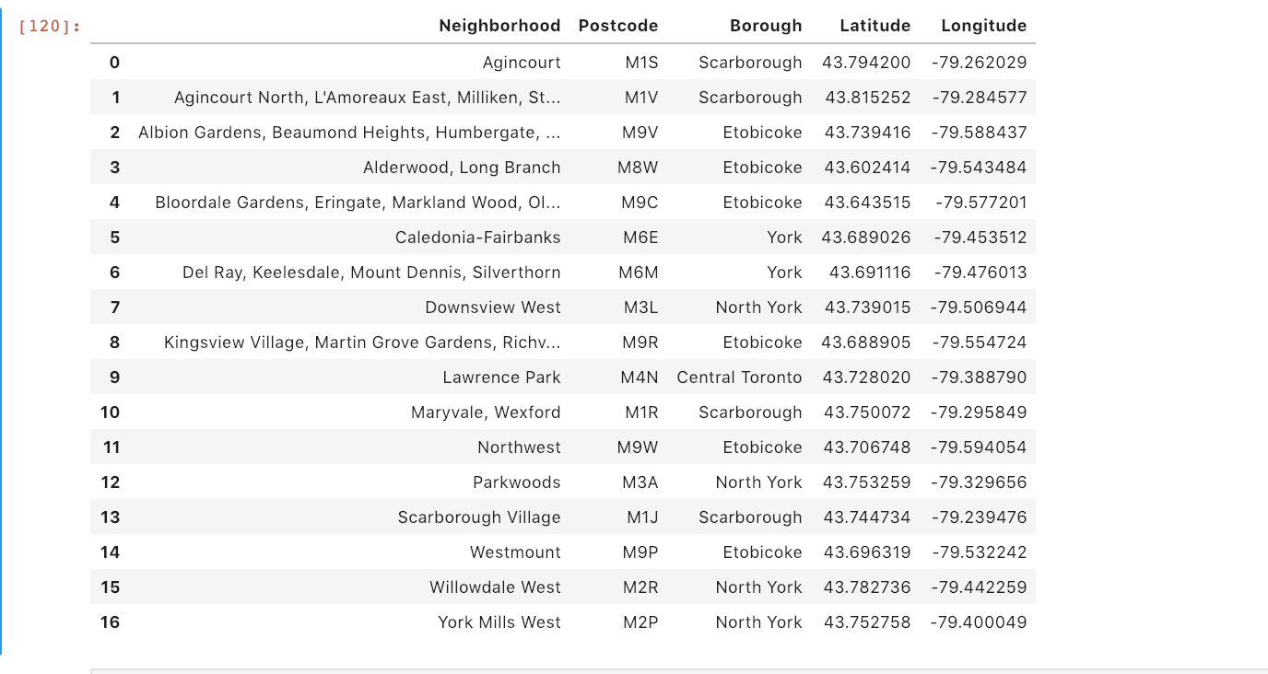
Neighbourhood with Low density

Slide 6
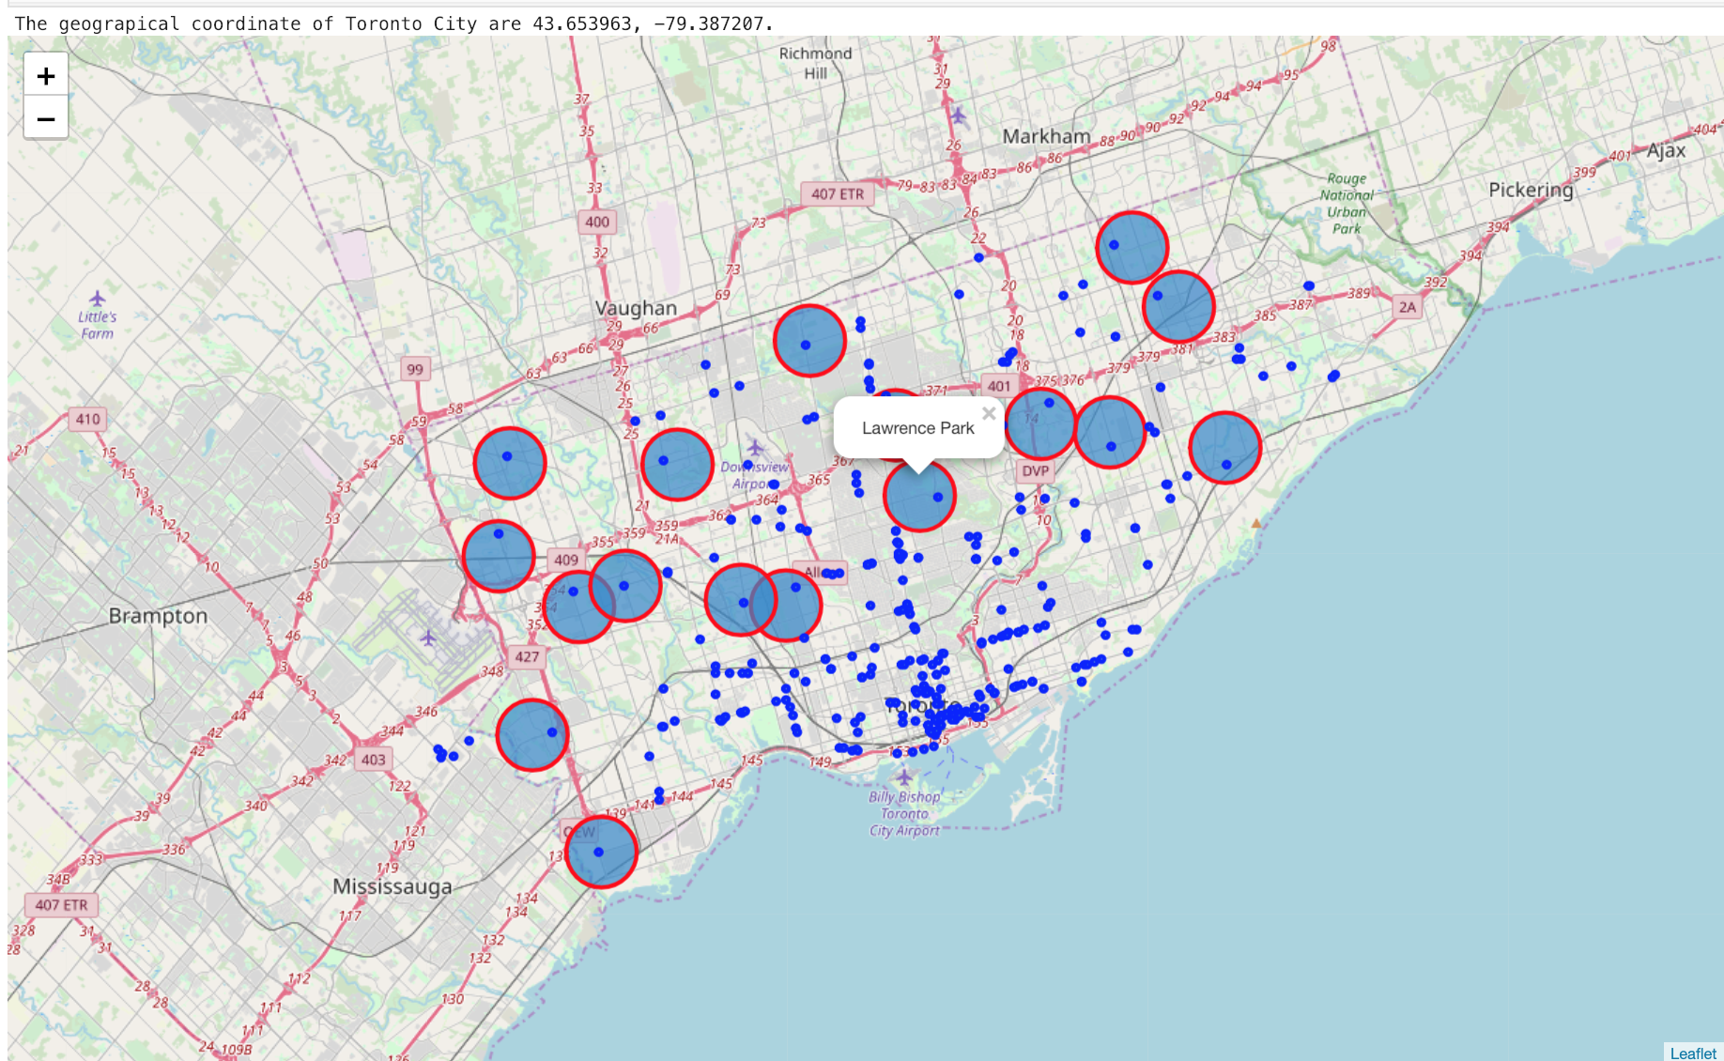
Suggestions

Slide 7
Existing Coffee Joints

Slide 8
Conclusion
These suggestion are based number Coffee shops in that area.
Further research around other parameters like type of neighbourhood, population etc is recommended.

